Slide 1
Quantitative Relation between Modulational Instability and Several Well-known
Nonlinear Excitations
Li-Chen Zhao
Northwest University, China
Shanghai 2015.06.18

Slide 2


Nonlinear partial equations
NLS
N. Akhmediev, L.M. Ling, J.S. He, C.Q. Dai, Y.Q. Zhang, …
K-E
L.C. Zhao, C. Liu, Z.Y. Yang, CNSS (2015)
Hirota
C. Liu, Z.Y. Yang, L.C. Zhao, W.L. Yang, PRE (2015)
S-S
L.C. Zhao, S.C. Li, L.M. Ling, PRE (2014)
... ...

Slide 3



CNLS
L.C. Zhao,J. Liu, JOSA B (2012); PRE (2013); PRE (2014).
F. Boranio, S.H. Chen, Y. Chen, …
PT-CNLS
L.C. Zhao, L.M. Ling, Z.Y. Yang, J. Liu, CNSS (2015)
... ...

Slide 4
The well-known nonlinear excitations for NLS desribed systems
When
no modulational instability
dark soliton has been found on nonzero background
When
modulational instability exist
bright soliton(BS)
has been found on zero background
Akhmediev breather(AB)
Kuznetsov-Ma breather(K-M)
Peregrine rogue wave(RW)
have been found on nonzero background

Slide 5
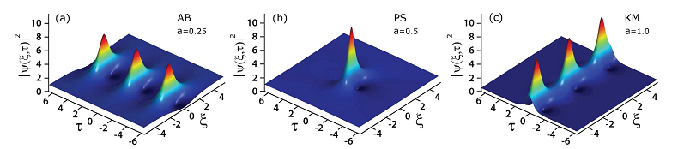
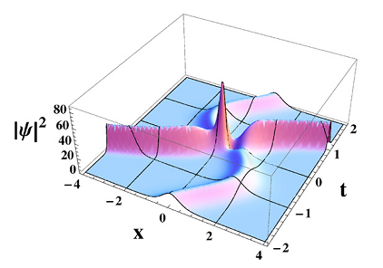
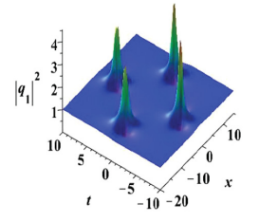
Several well-known nonlinear excitations of NLS described system

Slide 6
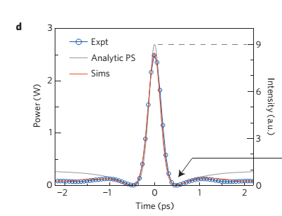
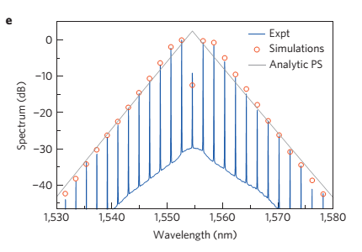
The experimental realization on RW
B. Kibler, J. Fatome, C. Finot, G. Millot, et al., Nature Phys. 6,790 (2010)

Slide 7
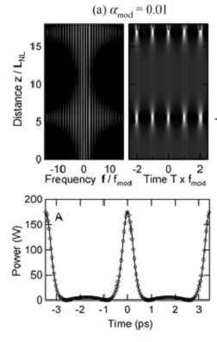
The experimental realization on AB
J. M. Dudley, G. Genty, N. Akhmediev, Opt. Express 17, 21497 (2009)

Slide 8
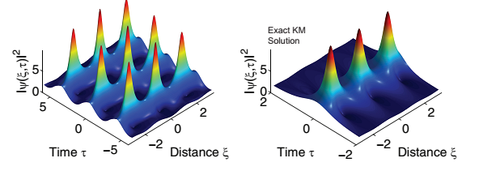
The experimental realization on K-M
B. Kibler, J. Fatome, C. Fnot, G. Millot, G. Genty, etal., Sci. Rep. 2, 463 (2012)

Slide 9
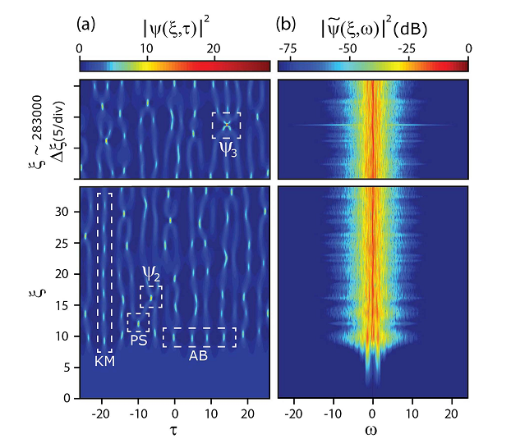
Fundamental excitations and high-order ones can be generated from a noise on a continuous wave background
S. Toenger, T. Godin, M. Erkintalo, G. Genty, J. M.Dudley, Sci. Rep. 5, 10380 (2015).

Slide 10

The MI analysis on continuous wave background of NLS
The dispersion relation can be derived as
?
can be used to descibe the growth rate of each perturbation on the CW background

Slide 11
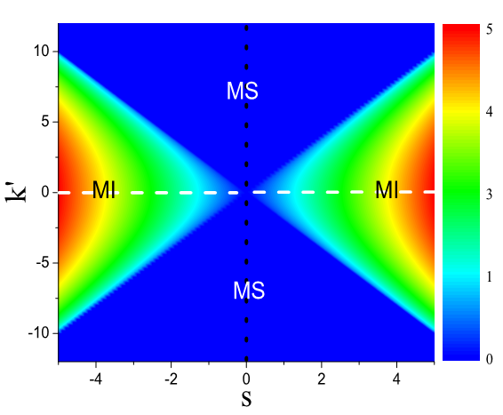
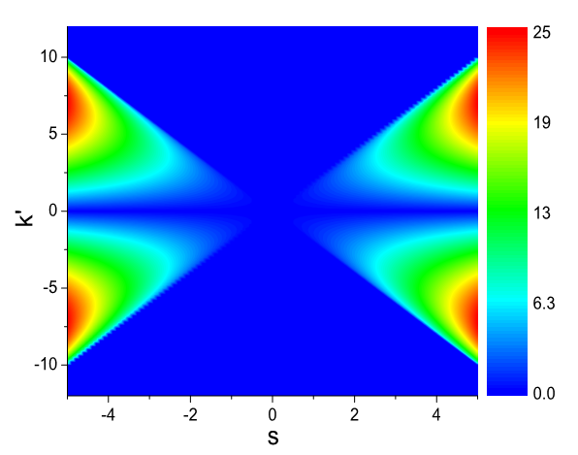
Which MI gain form is more reasonable？
The first MI gain form
The second MI gain form

Slide 12
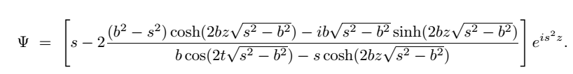

AB solution provide an exact way to investigate the growth rate of perturbations with different frequencies.
The growth rate of AB can not be denoted by , since there are the same exponential factor in both numerator and denominator part which makes the factor fail to describe the growth rate of AB near b → s.
The growth rate of AB can be reflected well by the localized degree(LD) of the AB unit.
Stronger localized degree corresponds to larger growth rate.

Slide 13
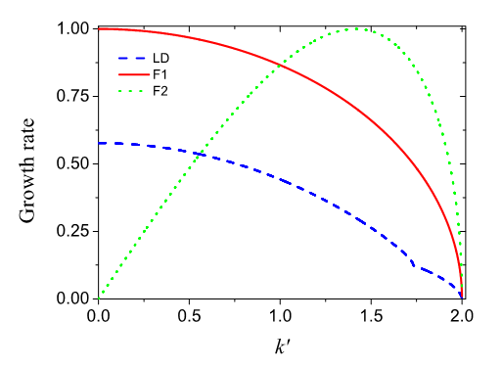
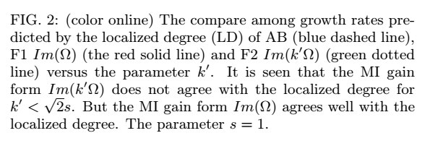

Slide 14
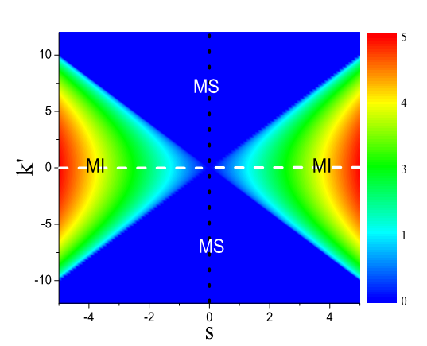
The most comparisons between MI and the nonlinear excitations are qualitative rather than quantitative.

Slide 15
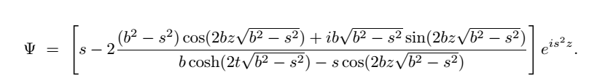

How to certify the relations between MI and nonlinear excitations ？
Define the dominant frequency and propagation constant for each solution on the CW background

Slide 16
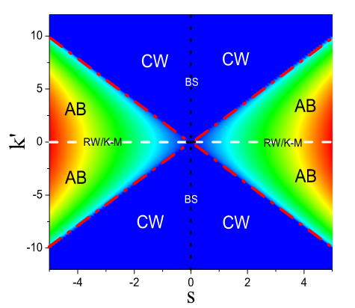

The quantitative relations between MI and nonlinear excitations
L.C. Zhao, L.M. Ling, arXiv:1410.7536v1 (2014).

Slide 17
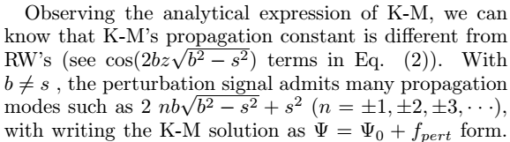
How to distinct RW and K-M ？
RW comes from MI under “resonance” perturbations for which both dominant frequency and propagation constant are equal to CW background’s.

Slide 18
Conclusion and Discussion
1. The quantitative relations between MI and these well-known nonlinear excitations are obtained, which can be used to direct controllable nonlinear excitations in NLS described systems.
2. RW comes from MI under “resonance” perturbations for which both dominant frequency and propagation constant are equal to CW background’s.

Slide 19
3. The breathing behavior of AB or K-M comes from the frequency or propagation constant mode difference between the dominant ones of perturbation signal and CW background’s
4. The similar studies can be extended to other nonlinear systems. For example, we have certified the relations for Horita, S-S model, and even coupled NLS model.

Slide 20
Cooperator
Liming Ling South China University of Technology
Zhanying Yang Northwest University, China
Shengchang Li Xi'an Jiaotong University
Chong Liu Northwest University, China

Slide 21

Thanks for your attention!

